Slide 1
AFTER YOU INSTALL GAMS
Adding GAMS to your system PATH in WINDOWS
Using the License File sent for the course

Slide 2


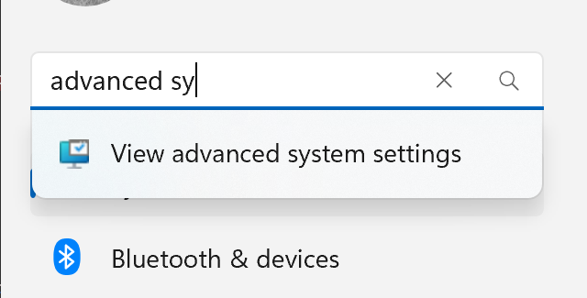


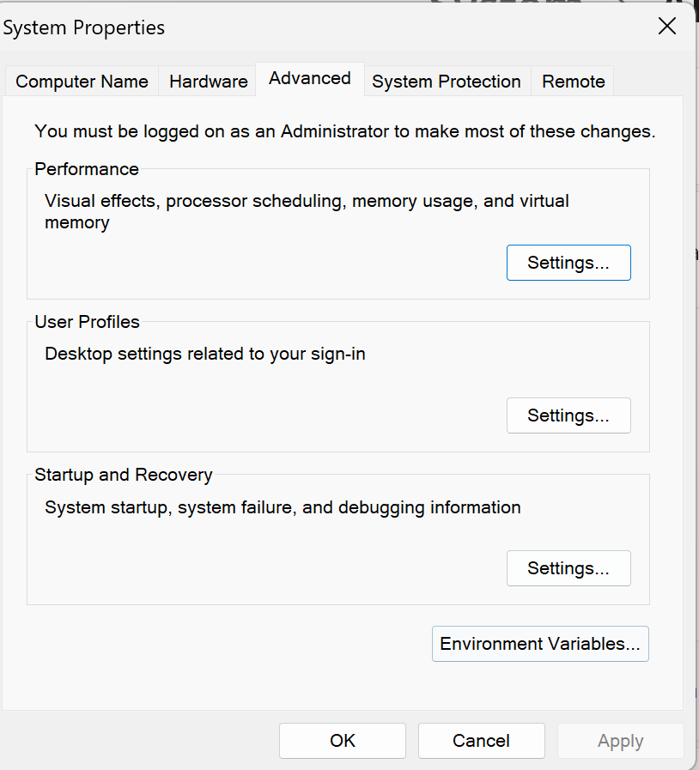
Click the Settings Icon
Type “Advanced System”
Click “View advanced system settings”
Click “Environmental Variables”

Slide 3
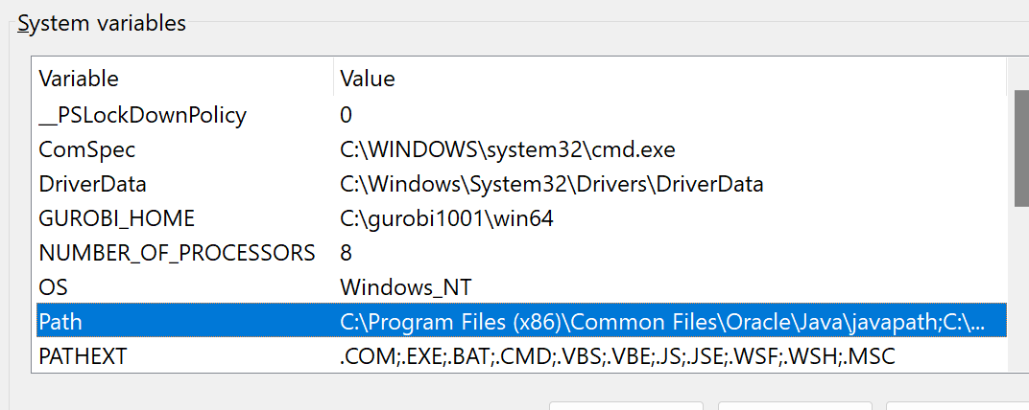
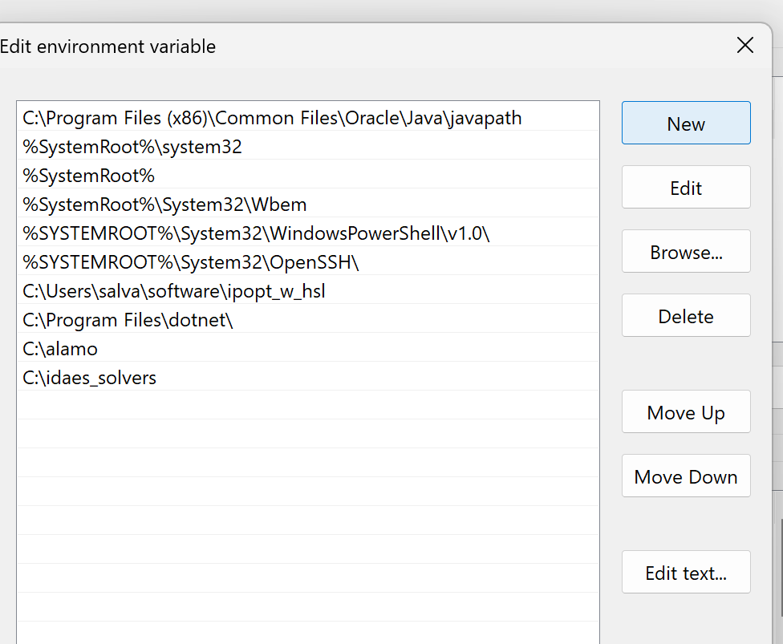
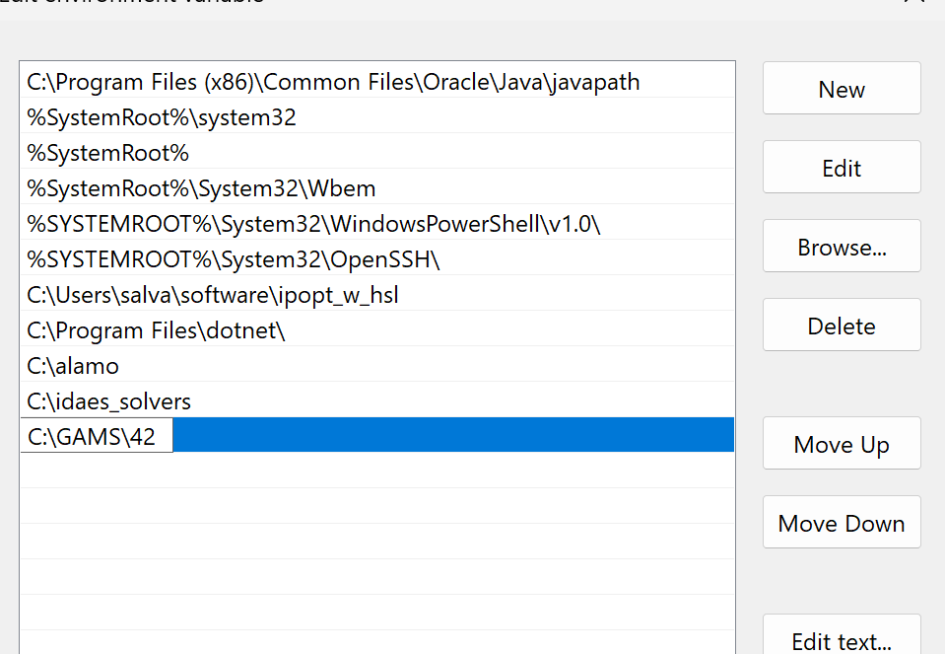
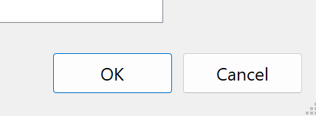
Double Click Path
Click “New”
Type or paste
The path to the GAMS
Install folder
8.Click OK in all
The windows

Slide 4
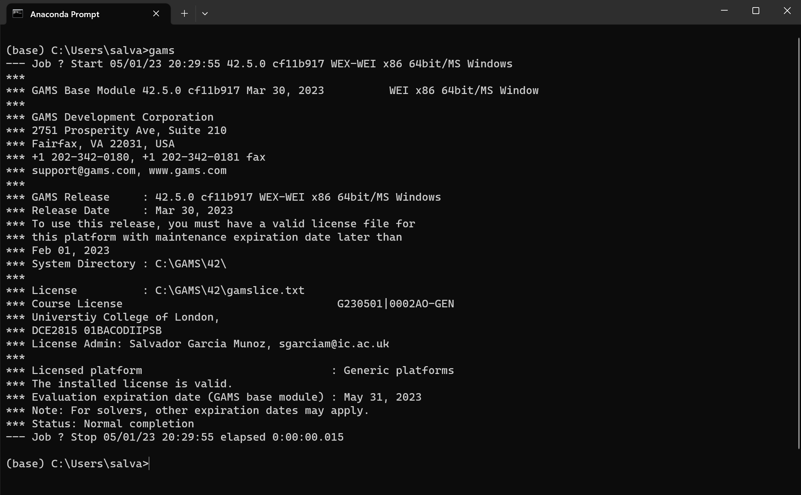
Open the Anaconda Prompt (or a cmd window) and type gams [hit Enter]
You should see something like this

